Slide 1
Lab1583-K23 – Mobile 201 Boost usage and adoption of your mobile apps
Greg Pietro
Advisory Solutions Consultant

Slide 2
Overview and Preparation
Lab Scenario
You have been tasked with updating the out-of-the-box field service mobile Agent experience for your organization’s field technicians. Your requirements:
Highlight the most important fields for your technicians to take action on for their work order tasks
Personalize the home screen to align with corporate branding by customizing the icons, images, and banner
Sections - What it Covers
Download and login to the ServiceNow Agent mobile app
Customize the ‘My Tasks’ list screen card
Configure a UI rule to highlight important fields on the ‘My Task’ list screen
Change the mobile icon for ‘My Work’ navigation tab
Create a new icon section using your own custom-branded images
Create a company-branded mobile banner to the top of your home screen

Slide 3
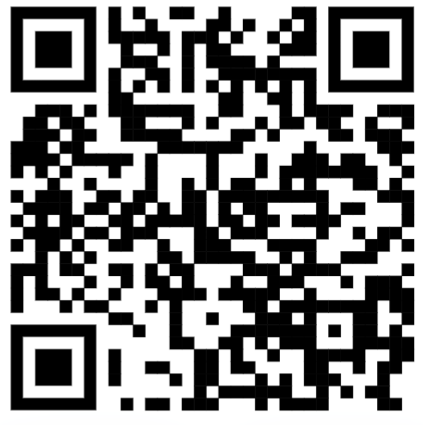
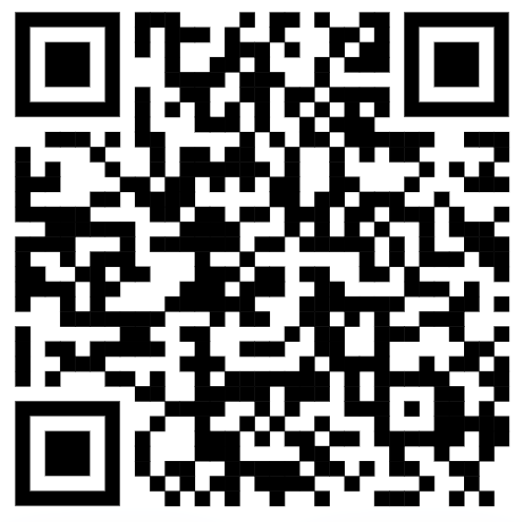
Lab Details
Lab Details
QR Code Link
Lab Guide
https://tinyurl.com/MOB1583
Reservation Link
https://tinyurl.com/RES1583
Lab Guide: https://github.com/gapietro/LAB1583
Number: LAB1583
Lab Name: Boost usage and adoption of your mobile apps
Instructor instance count: 2 Student instance count: 35
Student password: PwujzQfmVLzB
Registration URL: https://clabs.link/van-mar-9092
Reservation code: 3NVWB

